Slide 2
Git and SAS®: A Match Made in (SAS) Studio
Joe Matise, NORC at the University of Chicago
Joe has been a SAS Programmer for nearly 15 years, with experience in data analysis, reporting, and SAS Administration. He is active in the SAS Community, particularly on Stack Overflow, the SAS-L listserv, and most recently two-time winner of The SAS Bowl trivia challenge.
Notes:
Hi, I’m Joe Matise, and I’m here to talk to you about Git and SAS Studio. Whether this is your first time thinking about using Git, or you’re a seasoned Git pro, SAS Studio should

Slide 3
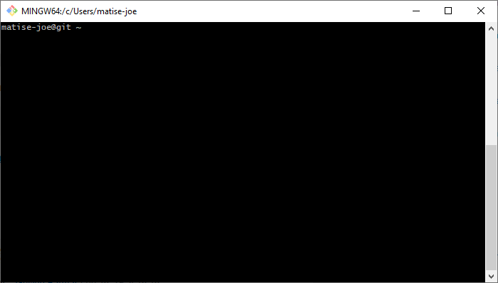
Notes:
(Picture of the Git command line interface)
What word would you use to describe the feeling you get when you see this window? Trepidation? Fear? Confusion? Or are you comfortable with this, knowing you’re only a few commands away from submitting your code to its safe place in the cloud, whether internal or external?
For many of us, the command line is, at best, a necessary evil, and often a place that we dread.

Slide 4
Git and SAS®: A Match Made in (SAS) Studio
Road Map
Overview of how Git works
Setting Up your Git Profile in SAS Studio
Walkthrough of basic Git operations
Notes:
Today, we’re going to give a brief overview of how Git works (--click). Then, we’ll walk through setting up your Git profile in SAS Studio (--click). Finally, we’ll step through some basic Git operations using SAS Studio’s interface.

Slide 5
Overview of Git

Slide 6


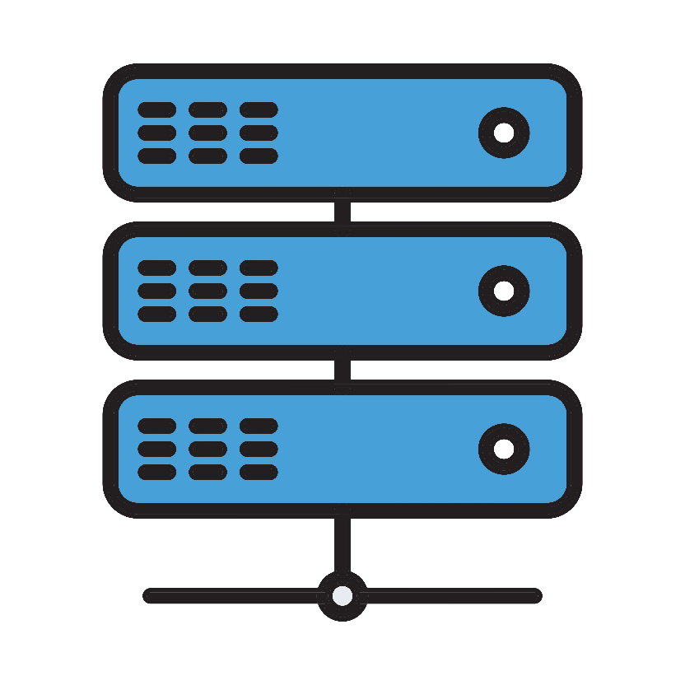
Git Client/Server Basics
Your Code
Your PC
Your Git Server
Commit ->
Push ->
<- Pull
https://commons.wikimedia.org/wiki/File:Computer.png
https://pngtree.com/freepng/vector-server-icon_4973694.html
Notes:
Git has a local copy of the repository stored on your PC, or on your network share where your files are stored. For SAS Studio, we usually have to have the files stored on a network share or other server-accessible location, but the important part is that this is local to where your code lives. Small changes are updated to that through a process called a “Commit”, as often as when a file is changed in a meaningful way – think of this as the “Save” command!
You likely also have a server that stores your Git – that server copy is updated through a process called “Pushing”. This is done less often, usually when you are ready to share your changes with others.
You similarly can update your local copy of the files from the server through a process called “Pulling”. This is done when you want to update your code with changes others have made, or just want to get the most up-to-date version of code.
Good news – there is a way to do all of these things inside SAS Studio!

Slide 7
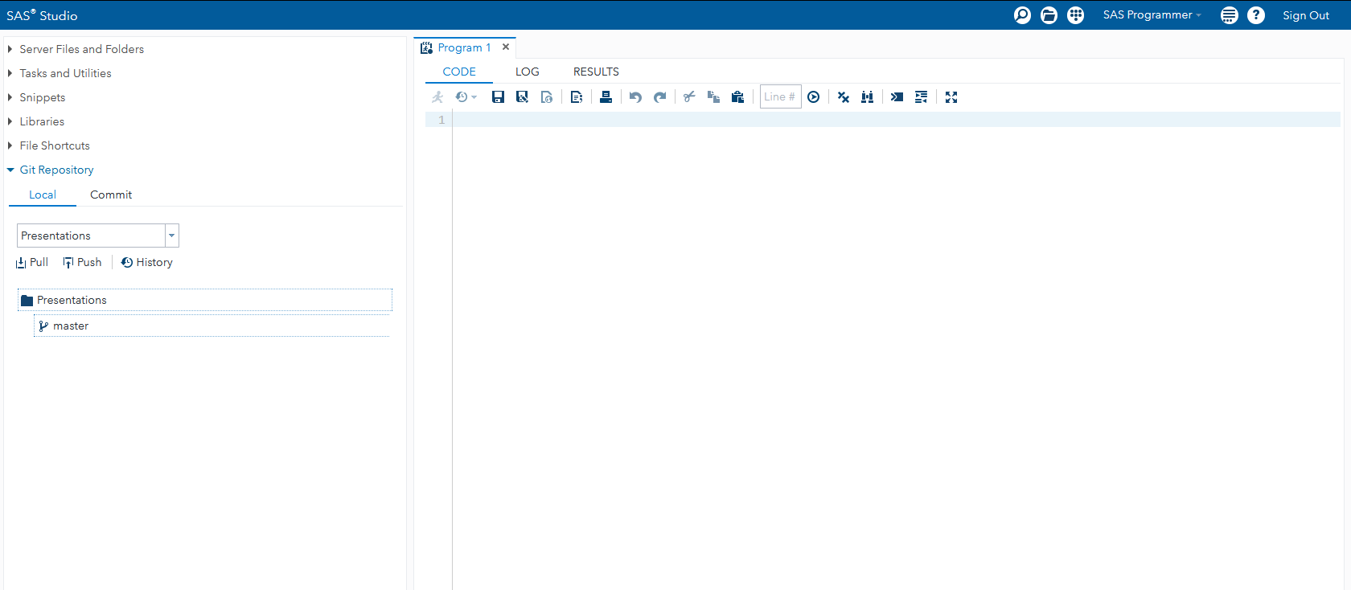
SAS Studio with Git
Notes:
(Picture of SAS Studio with Git)
Starting with SAS Studio version 3.8, you can now access most commonly used Git operations without leaving your browser!
You can commit changes, push code to the Git repository server of your choice, pull code down from that server, work with branches, and more, all from inside the SAS Studio interface.
Even better - if you already use Git, and have it installed locally, this is fully compatible with that workflow! Use the parts of this that are helpful, and use your already existing workflow for the parts you prefer to use that for.

Slide 8
Setting Up Your Git Profile

Slide 9
Setting up your Git Profile
What you need to get started
Git Server Address | GitHub, GitLab, Bitbucket, …
How to Connect | SSH | HTTPS
Your User Credentials | SSH Key, or Username/Password
Notes:
You’ll need some information before we get started. You’ll need the address of your Git Server, which might be something like Github, Gitlab, Bitbucket, or another solution. You’ll need to know how you are going to connect to that server, which can be using SSH or using HTTPS. And you’ll need the necessary user credentials for making that connection.
Don’t worry if you don’t have all of that information – we’ll cover how to get that in this presentation.

Slide 10
Your Git Profile
SSH | HTTPS
Requires more up-front effort | Less work to set up
Can deal more easily with password changes | Need to update password when it changes
May be more secure* | Pretty secure, but requires caching password
Notes:
You have two ways to authenticate to your Git server. This only applies to operations involving the Git server – Git local doesn’t need any more authentication than you’ve already done logging in.
HTTPS is the easier method, and if you don’t mind updating your password periodically may be the better option. It’s as secure as any HTTPS – you do have to cache your password for it to work, which your administrator has to enable, but it’s saved in a secure format. This only works after the hotfix for Studio 3.8.
SSH requires more work up front, but won’t need to be updated every time you change your password – it’s authenticating you with a keyfile. The one big caveat is that currently, this only works if you do not have a password on your SSH key – which is not ideal, security-wise, and could be a deal breaker for some IT. Hopefully, SAS will update this!

Slide 11
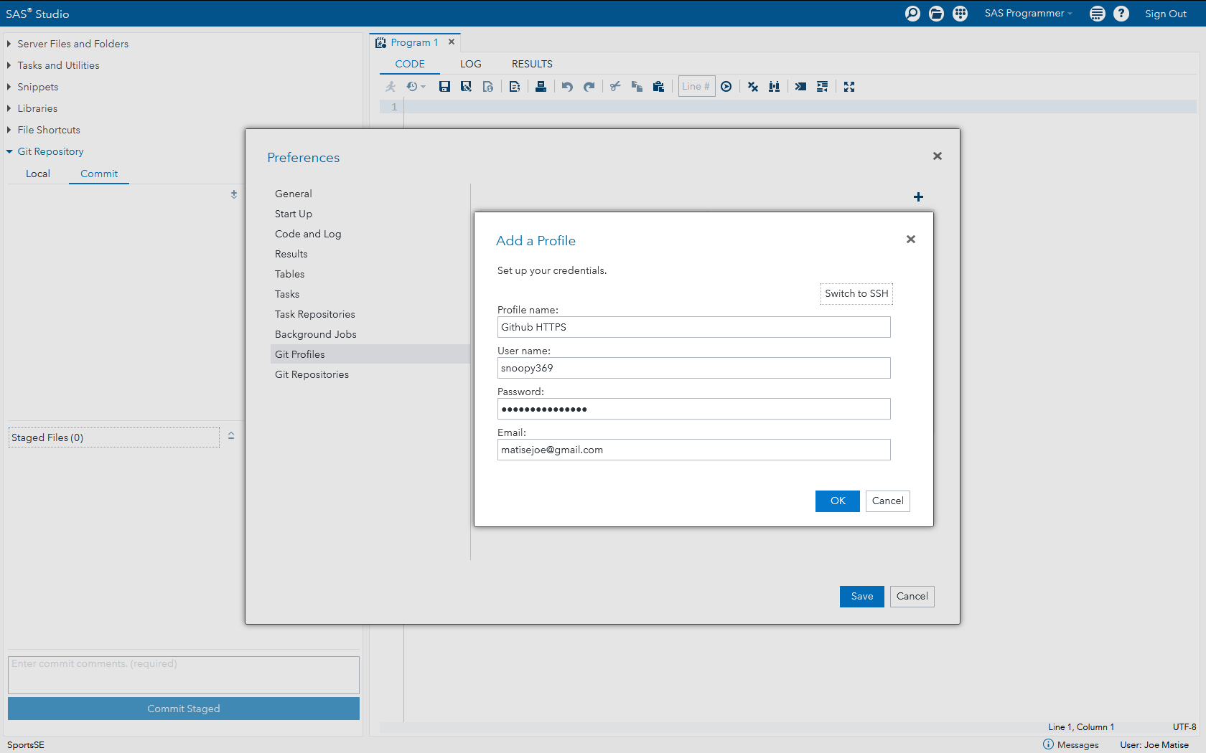
Setting up a Git Profile
HTTPS Edition
Notes:
(Picture of Add a Profile screen)
To set up using HTTPS, start with the Preferences dialog from the upper right-hand hamburger menu. Select Git Profile, then hit the + icon in the upper right.
Next, select “Switch to HTTPS”.
Here, put in the name you want to give the profile, and enter your login credentials.
That’s it – unless your credentials change, anyway!
If you are using GitHub, and want to use HTTPS, they are changing how they use HTTPS later this year. Look up ‘token authentication’ and Github for more details.

Slide 12
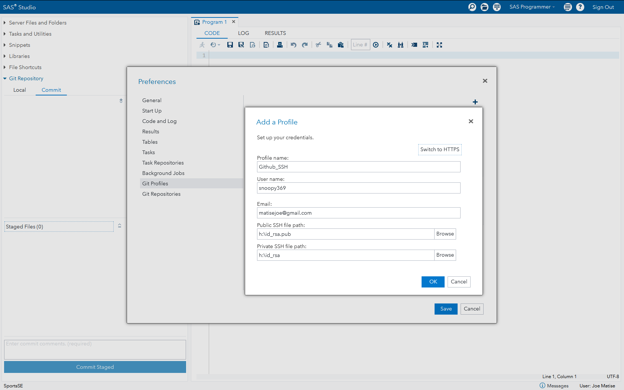
Setting up a Git Profile
SSH Edition
Notes:
(Picture of Add a Profile Screen)
Setting up a profile with SSH is done in largely the same manner. Preferences, Git Profiles, Add a Profile.
Here you need your SSH key, usually “id_rsa” (your private key) and “id_rsa.pub” (your public key).
If you don’t have those – no worries, we can make them! If you don’t mind a *tiny* bit of typing things in at the command line…

Slide 13
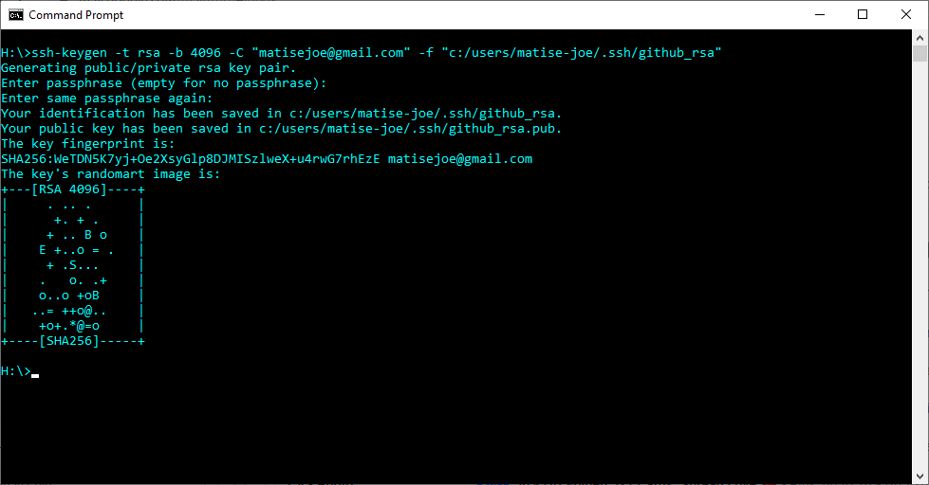
Setting up a Git Profile – SSH Key generation
We know we said no command line… this is the only one, we promise!
No, this is not my real public key.
Notes:
(Picture of a MS-DOS command window with a ssh-keygen command and its results)
Creating a public key, you need to use the ssh-keygen command. This is an optional feature in Windows, is usually pre-installed in Linux, or comes packaged with Git for Windows if you install that. Exactly how you generate the key may vary slightly depending on the requirements of your Git host server, so look up their documentation for connecting via SSH, or ask your IT department if you use an internally hosted solution. This example is a common use case, and works for Github. Do make sure to leave the passphrase empty – there is not currently a way to enter a passphrase in SAS Studio.
The files this creates must be saved to a location your SAS Studio session can see – if they’re created on the local drive, you can copy them to the server using the built-in Studio upload button, or copy them over yourself.

Slide 14
Basic Git Operations

Slide 15
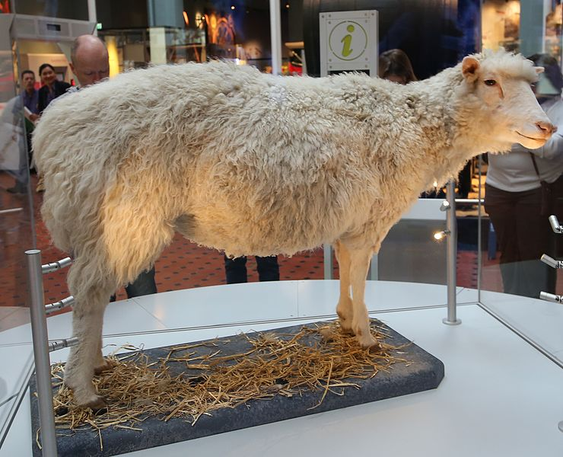
Cloning!
https://commons.wikimedia.org/wiki/File:Dolly_the_sheep_2016.JPG
Notes:
(picture of the preserved Dolly, the famous first cloned sheep)
No, we’re not talking about Dolly! Cloning with Git refers to the process of creating a new local repository as a copy of an already existing repository. It’s how you usually will bring your files to your local PC, and into SAS Studio, from your Git server.
If you want to go the other way around – take files in SAS Studio and put them in Git – no worries; we have you covered in a later slide!

Slide 16
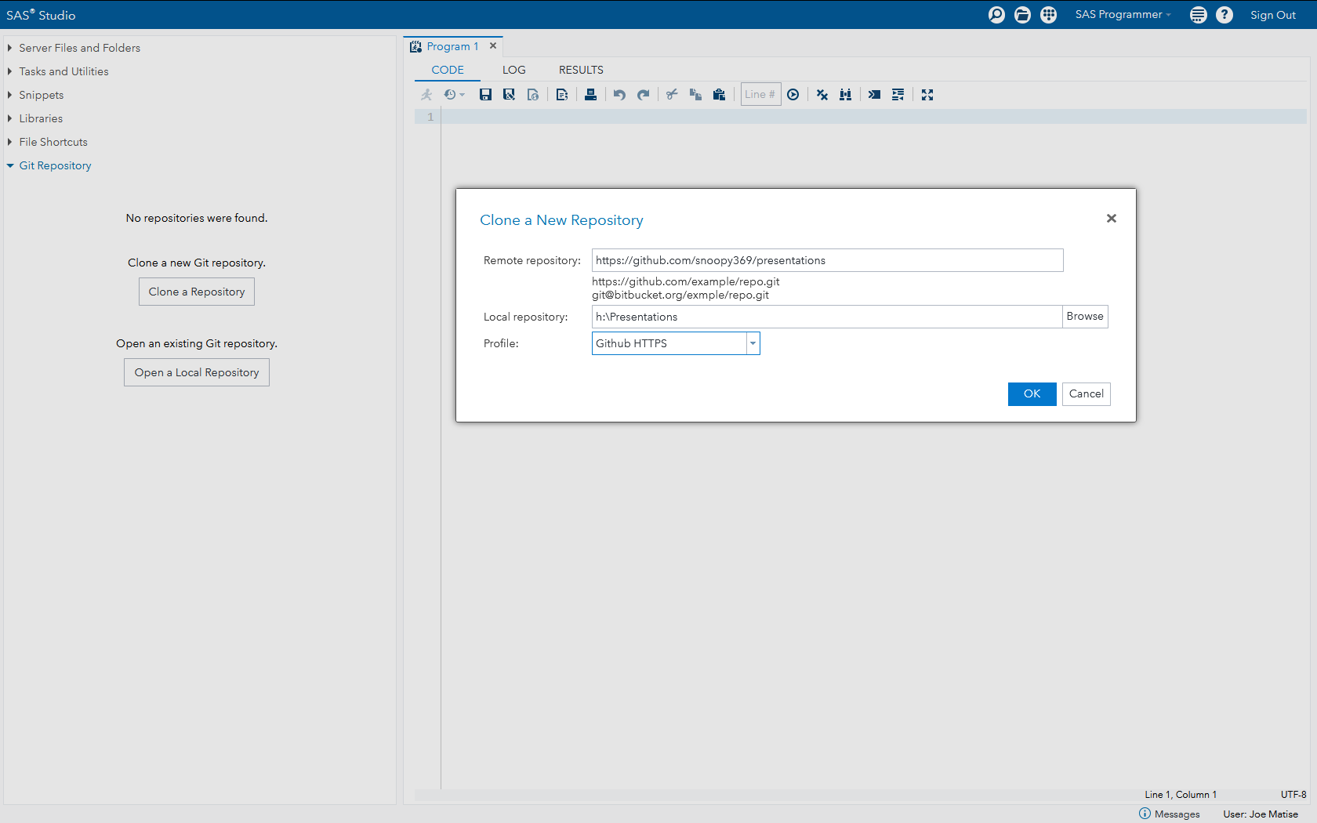
Git Operations: Clone a Repo
Notes:
To clone our first repository, go to the Git Repository section, and select “Clone a Repository”. Then, put the url for your repository in the “Remote repository” box, and enter where you want it saved on the server in the “Local repository” box. You may need to Browse to create the folder on your server first. Select your profile (if you have more than one, otherwise it should be selected automatically, and hit OK!

Slide 17
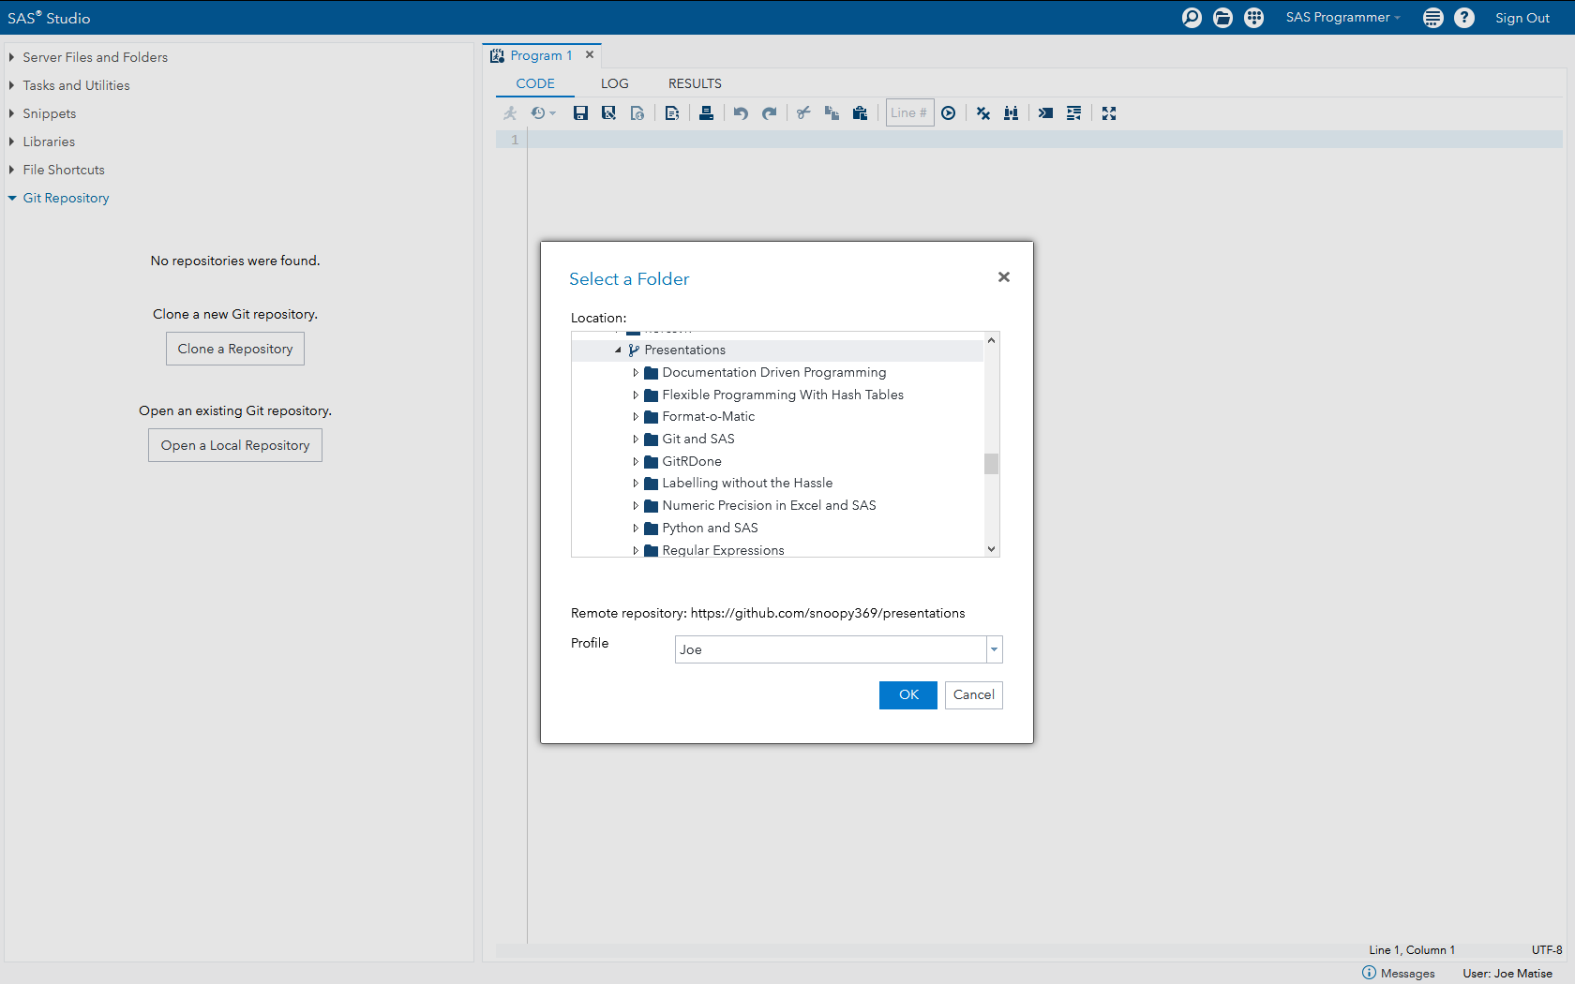
Git Operations: Open a Local Repo
Notes:
If the repo already exists, just select “Open a Local Repository”, and browse to it. When you select the right folder, it should show the Remote Repository, as this one does. Select your profile, and hit OK! You’ll notice that it has a different icon – even if it’s not loaded in SAS Studio, SAS recognizes that you have Git set up on the folder, and gives it a special icon.

Slide 18
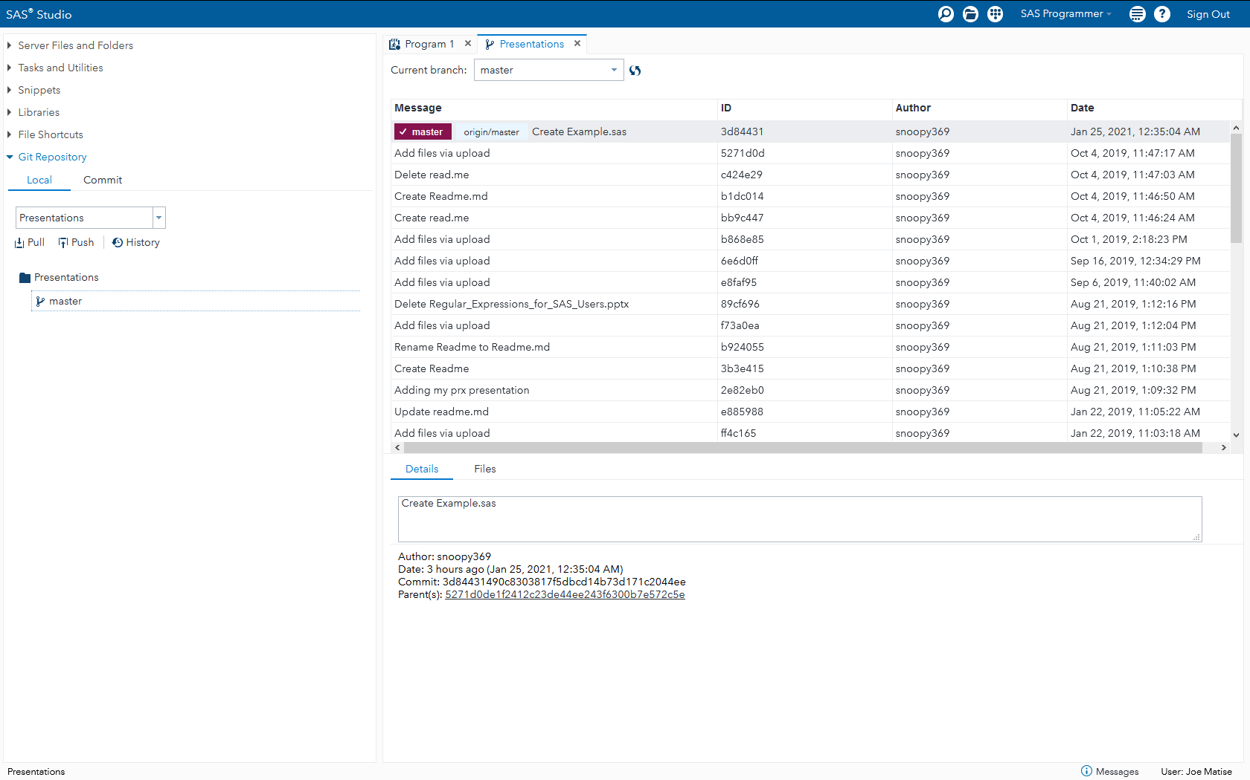
Git Operations: Viewing the History
History of a Repo, Part One
Notes:
Now that we have cloned our repository, it shows up in the Git Repository section.
We can view the history of the repo by clicking the History button. This shows us all commits prior to when we cloned the repo.
Notice how there are quite a few commits already on my repo!

Slide 19
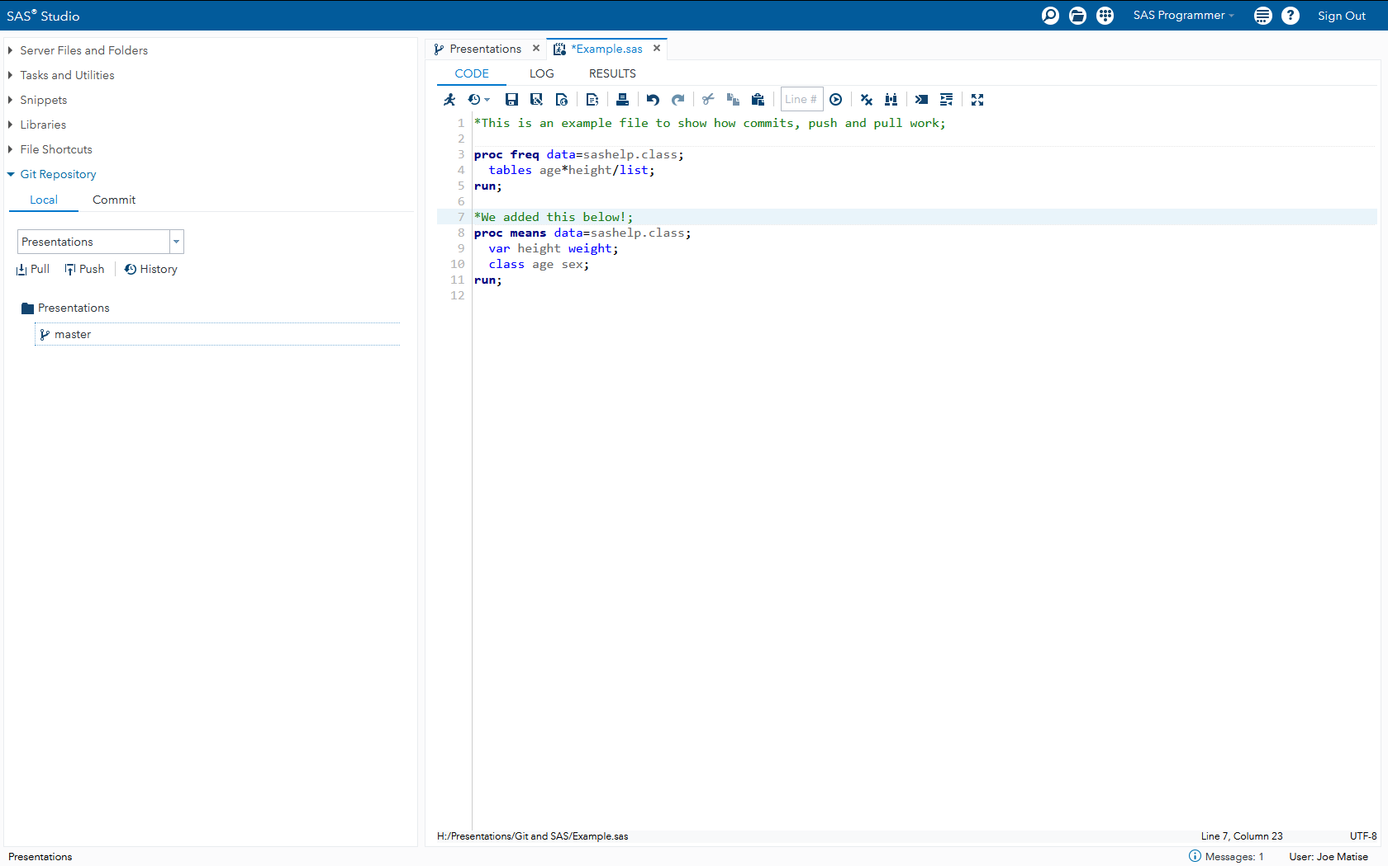
Making a Change!
Notes:
Let’s test opening a file and making a change. We’ll open the Example.sas file, and add a few lines of code.
First, open the file from your Server Files and Folders menu, like you probably usually open SAS programs.
Then, make a change – I added a PROC MEANS step here.
Then, save, just like normal.

Slide 20
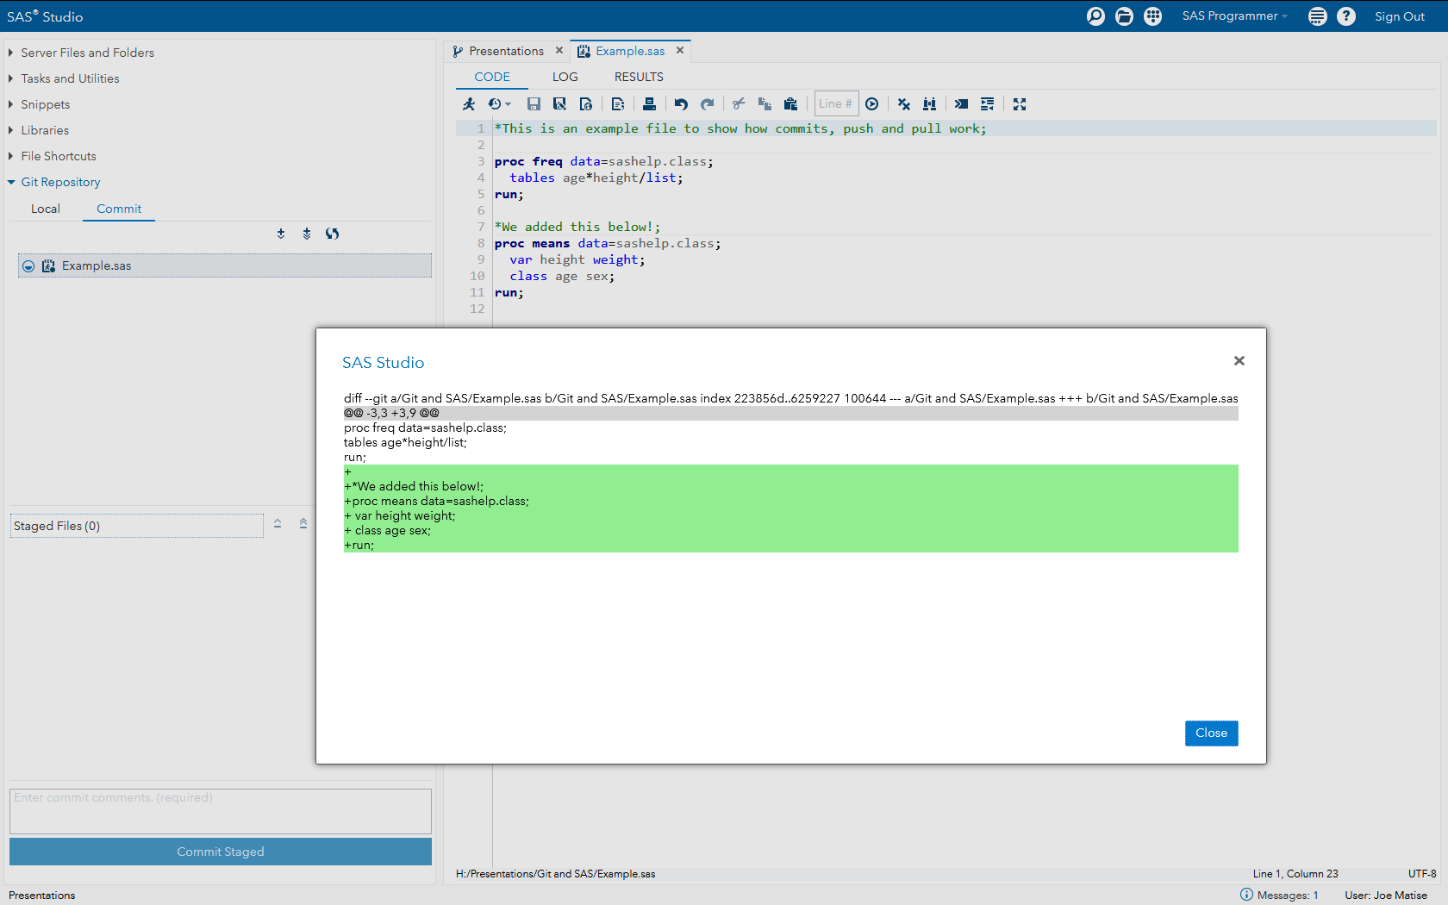
Git Operations: Verifying Changes
Notes:
Before we commit, let’s first see what we changed! Select the Commit tab, then right-click on the file; you see a few options, one of which is “Show Differences”. Select that.
You will see a window that shows what was added, deleted, or changed since the last commit. You can go down, line by line, and verify that everything is good.
When you are satisfied, you’re ready to really commit!

Slide 21
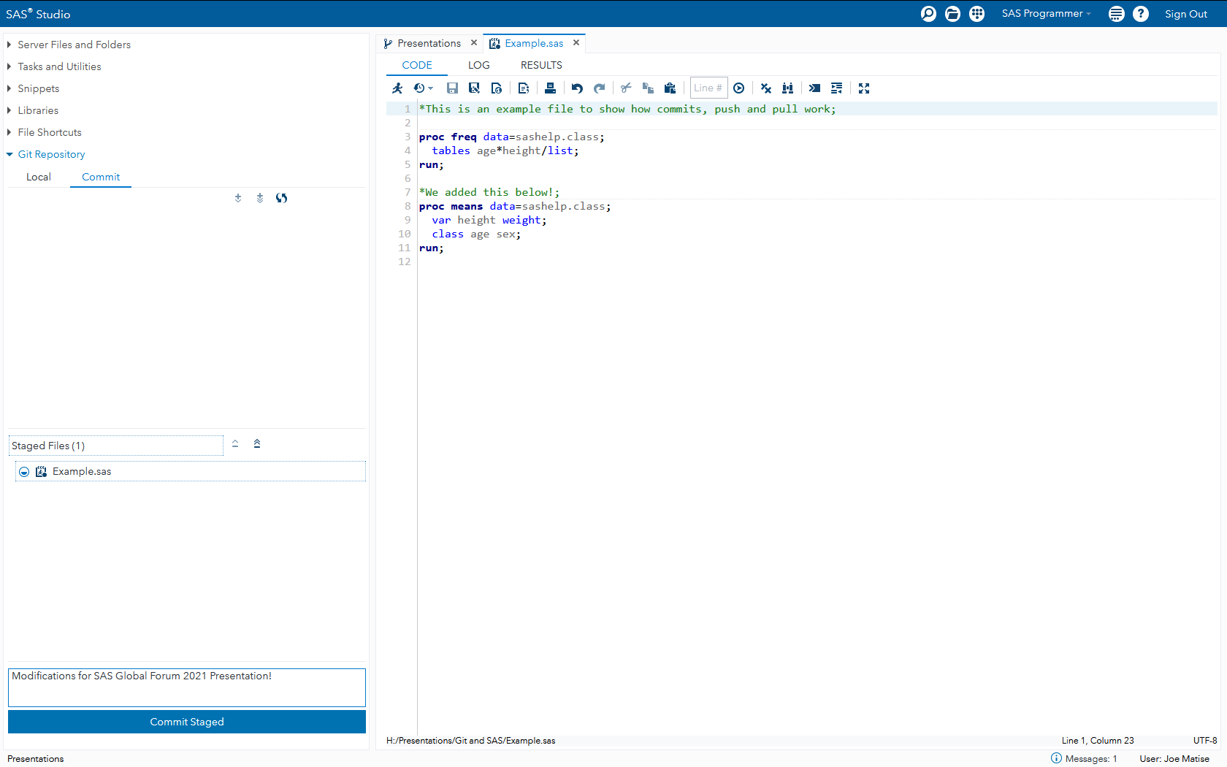
Git Operations: Commit Changes
Remember your descriptive Commit Message!
Notes:
Once you’re ready to commit, you first need to stage the files you are going to commit. You can right click on each one and stage them, or select “Stage all” – which is what I usually do – to move all files that have pending changes down to the ready-to-commit box.
Then, don’t forget to type in a descriptive commit message – this is what you see when you view that history, so make it something good!
Finally, select “Commit Staged” to commit the staged files to the repository.
Remember – this doesn’t send them anywhere; they’re just in your local folder still –we’ll get to sending them to the server shortly!

Slide 22
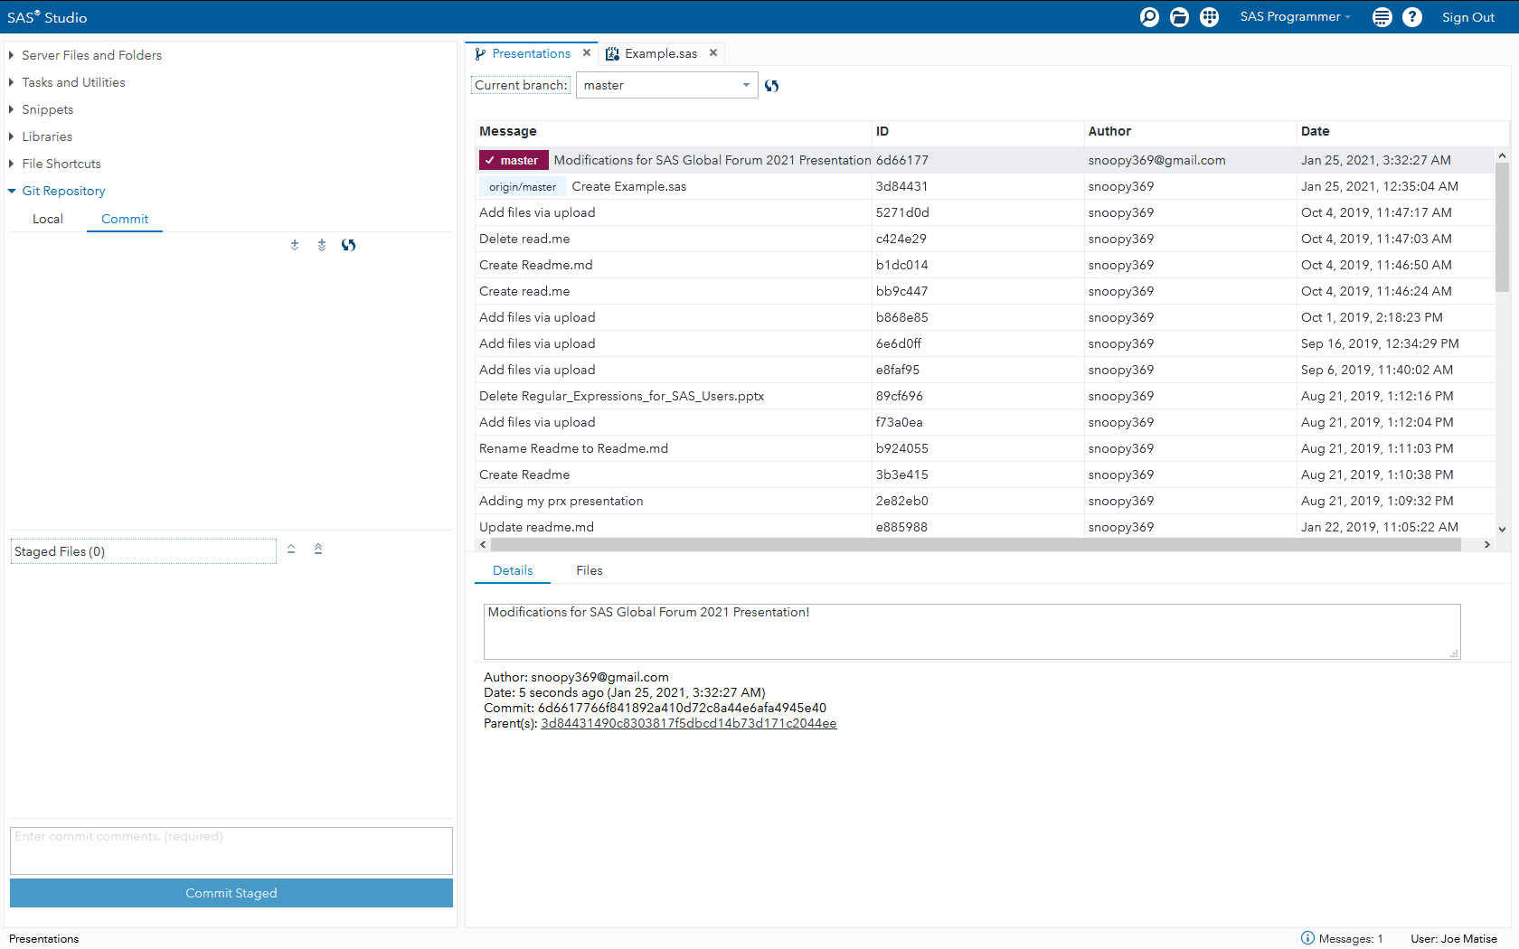
Git Operations: Viewing the History (again)
History of a Repo, Part Deux
Notes:
Here we can view our history again (select the History button, or go back to the prior tab and hit refresh). You’ll see a new entry now – and we can clearly see that our local repo is off of the server version. Notice how the maroon “Master” is on top, and there is a light blue “origin/master” – the latter is the server’s version. We’re ahead by one version, so let’s fix that so anyone else downloading this gets the new version.

Slide 23
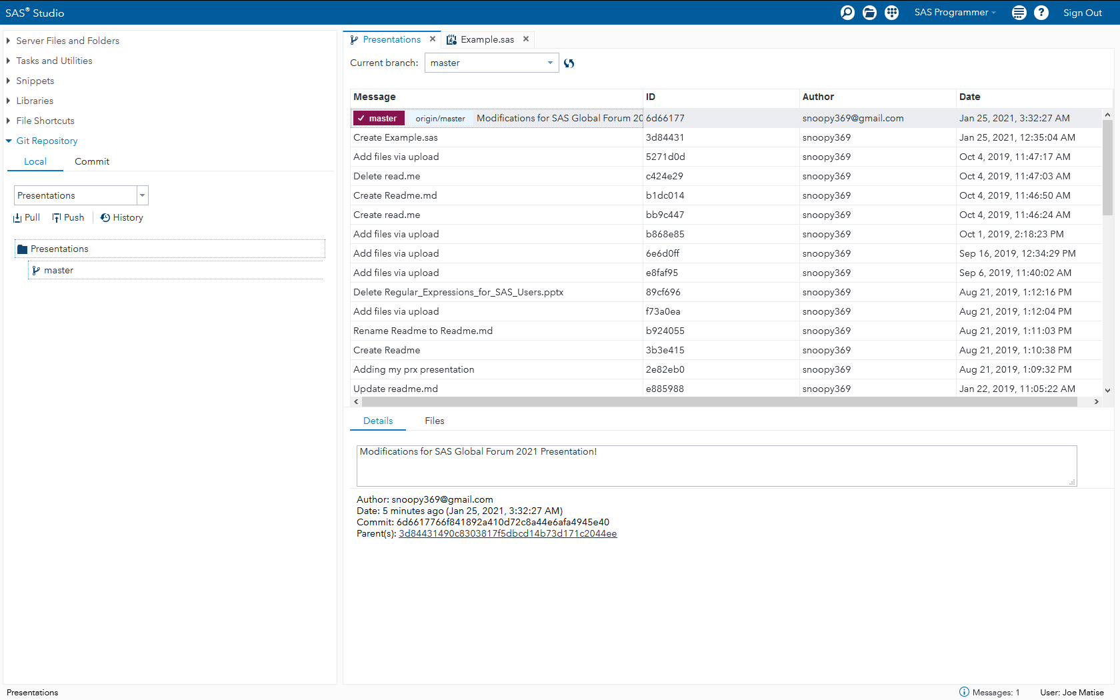
Git Operations: Push
History of a Repo, Part III
Notes:
To push, we just select “Push” from the repository screen. The screen will show a “Pushing” spinning circle briefly, and then it will refresh the history to show that the push was (hopefully) successful. Notice how the origin/master light blue line and our master maroon line are identical now? That shows the server and we agree once again, and anyone else pulling down a copy of this file will get my latest changes!

Slide 24
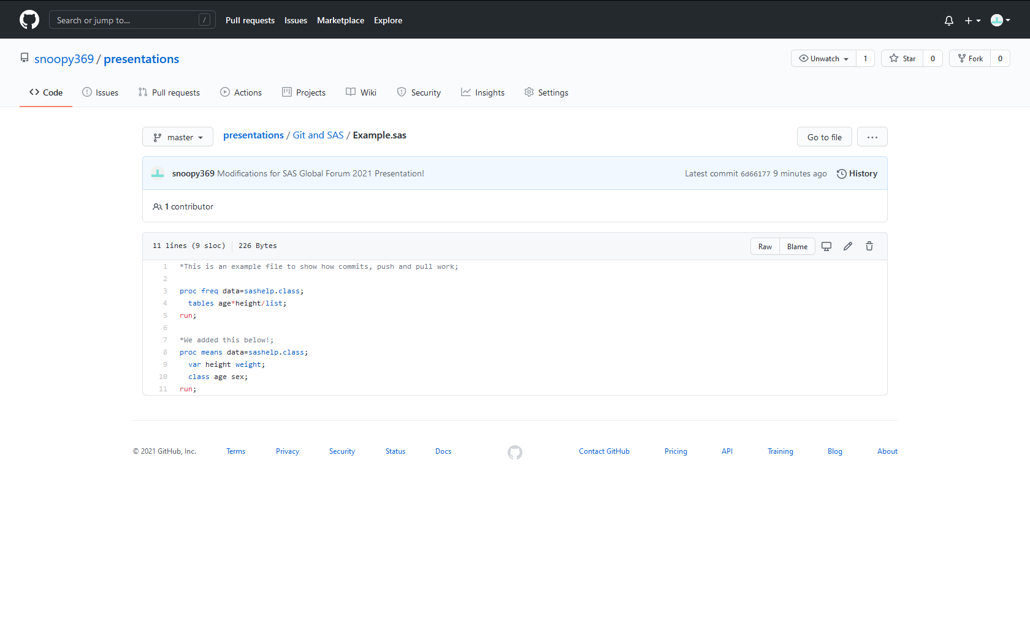
View our Changes on Github
Notes:
You can load the file on Github, and that see our changes made it to the server thanks to the “Push” operation! Now, let’s make a change in Github, to simulate one of our colleagues changing our source code.

Slide 25
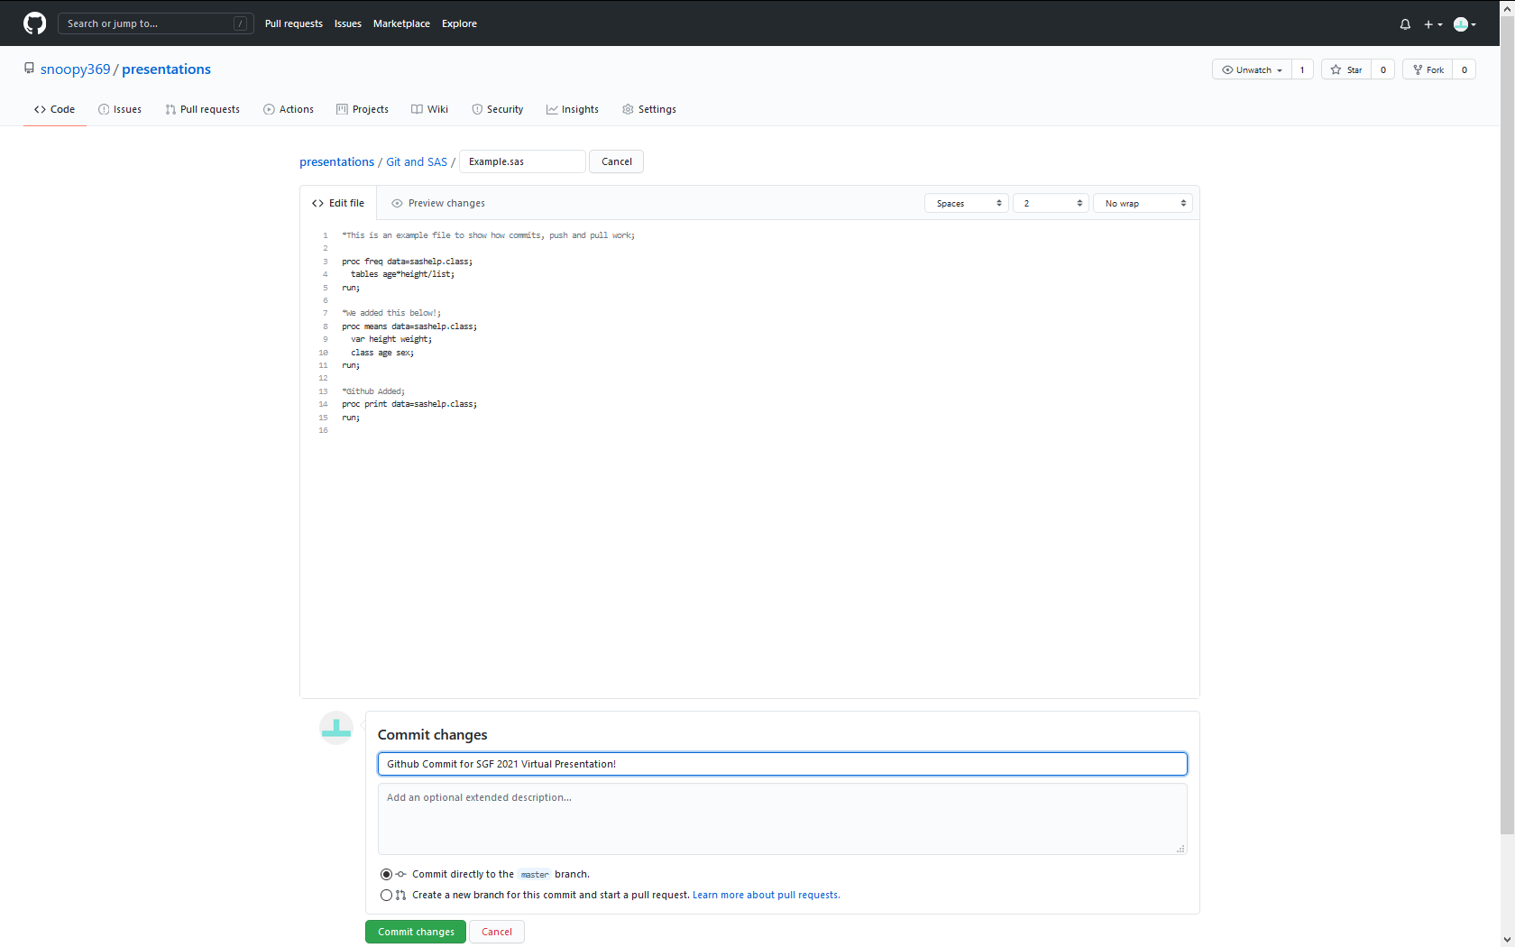
Simulating a change via Github
Notes:
We’ll make a minor change on Github, and put in a nice useful commit message. This will then make its way back to us locally, when we perform a Pull.

Slide 26
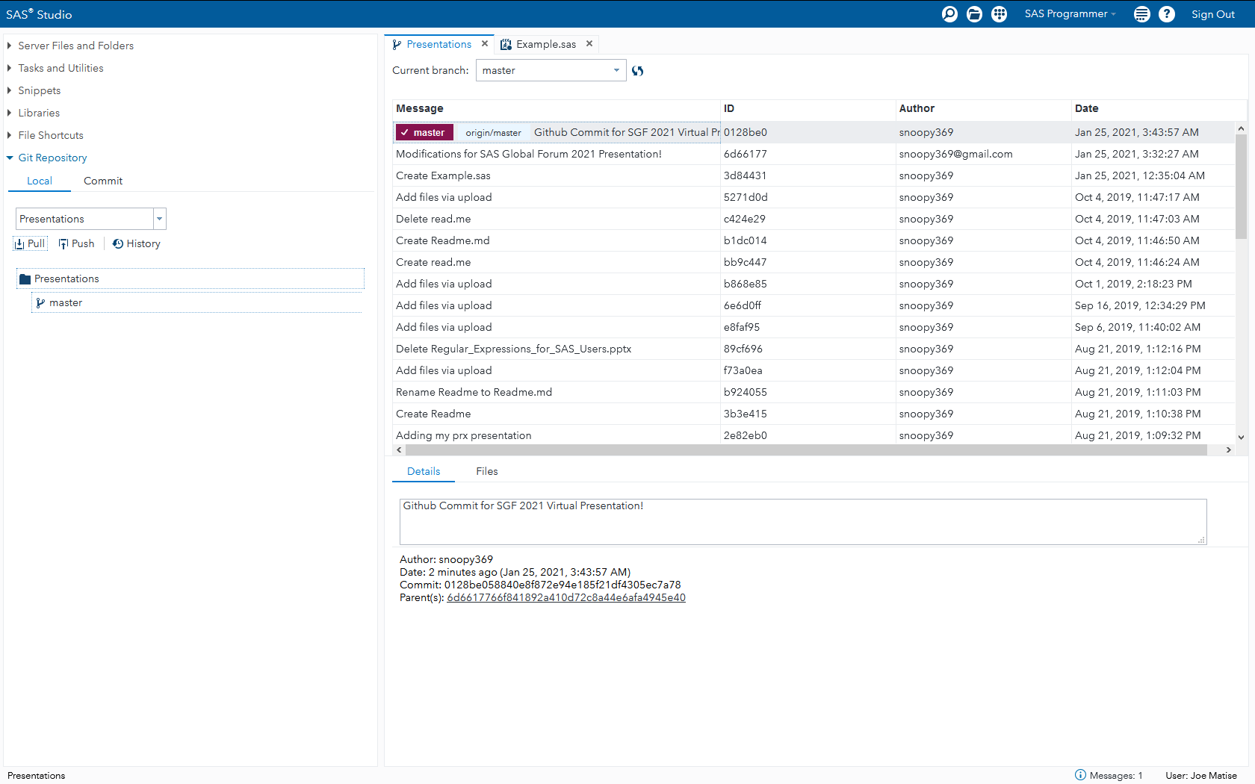
Git Operations: Pull
Notes:
Now, we perform a Pull operation the same way we did a Push: by selecting “Pull”, and waiting a few moments. The screen briefly shows “Pulling”, and then updates the history to show we now have the most up to date version of the file – with our newest Commit message – and you can see the prior commit message one step back.

Slide 27
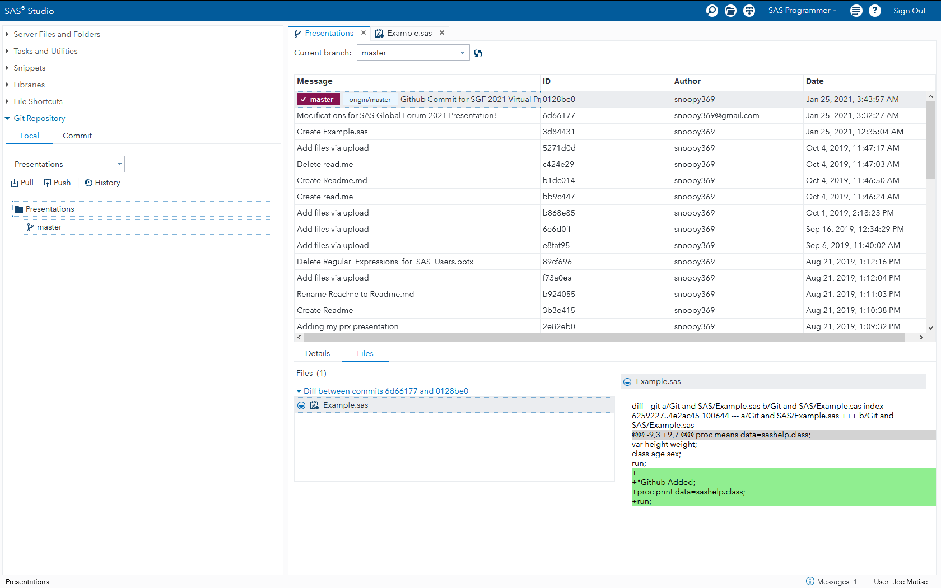
Viewing our changes
Notes:
To see what changed, we select the Files tab in the History window, and then click on the file. It shows you the Diff, or the changes, just as when we viewed those changes in the Commit section.
Remember that, unlike with Commit, we will not see changes made on the server until we’ve done a Pull. If you want to reject those changes, you need to use the “reset” option, available on a right-click on the particular revision you want to reset to.

Slide 28
Other Git Operations
See the SAS Studio Documentation for more!
Branches – Right Click in History
Creating
Merging
Resetting changes
Deleting a Repository
Notes:
We can do several other Git operations in SAS Studio; in particular, we can work with Branches, we can reset our changes, and we can delete repositories. See the SAS Studio User’s Guide on documentation.sas.com for more information on all of the thigns you can do with Git!

Slide 29
Thanks!
Thanks to the following people for helping contribute to this presentation!
José Centeno
Matt Kastin
Zeke Torres
David Trevarthen
Jeff Vose

Slide 30
Thank you!
For more information, contact me at:
matisejoe@gmail.com
Or, view my presentation repository at:
https://github.com/snoopy369/presentations
Notes:
And of course, thank YOU for watching – the presentation wouldn’t exist without an audience!

